Slide 1
Essentials of Hispanic Marketing: Cultural Insights for Best-in-Class Marketing

Slide 2
Understanding Hispanic Consumers on Three Levels
1
Demographics & Economic Opportunity
2
Cultural Insights for Best-in-Class Marketing
3
Media Landscape

Slide 3
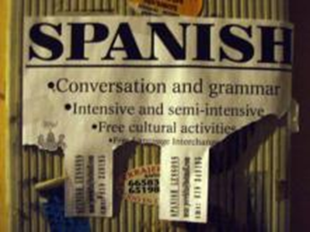
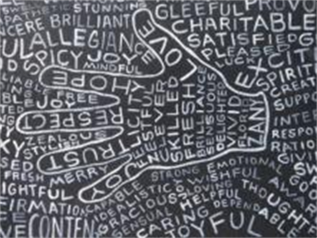
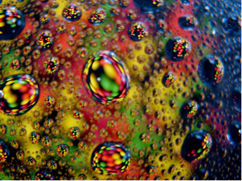
We’ll Explore Three Themes Today
United Language
Shared Values
Cultural Influence and Crossover

Slide 4
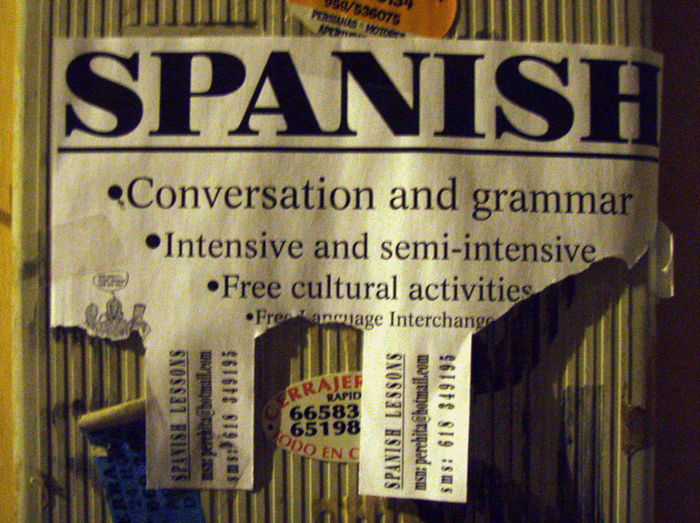
United Language
Image Source: Daniel Lobo “Español” https://www.flickr.com/photos/daquellamanera/

Slide 5
Language Has (At Least) Two Meanings—And Two Imperatives for Marketers
“The limits of my language mean the limits of my world.”
―Ludwig Wittgenstein
“Language is the blood of the soul into which thoughts run and out of which they grow.”
―Oliver Wendell Holmes

Slide 6
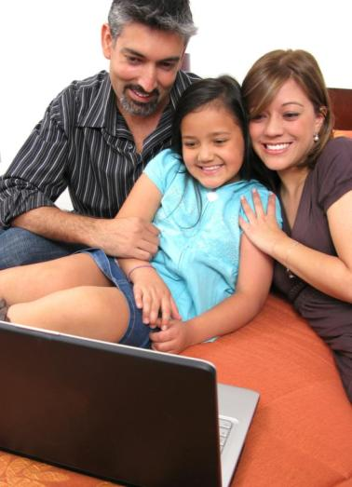
Spanish Language Unites Hispanics Across Origin Groups
74%
of Hispanics
speak Spanish
at home
Percent who Speak Spanish at Home
…although there are still dialects and nuances by country and region
Source: American Community Survey (2012) 5+ population

Slide 7
But How Stable is This? Introducing Functional Acculturation
Functional Acculturation: the ability to functionally navigate Anglo-American society
Unacculturated
Bicultural
Acculturated
35%
40%
25%
Language
Usage
Spanish speakers
Mixed Usage
Although have Spanish skills, usually use English
Self
Identity
Identify as Hispanic over American
A shared identity
More American
Language
Capability
Stronger with Spanish language than English
At least proficient in English
Very strong English skills
Increasing generations generally have increasing functional acculturation levels
Source: Latinum Network Analysis

Slide 8
Hispanics Keep Spanish Alive in the U.S. Across Generations
Language spoken at home by generation among California Hispanics (2011-2012)
95%
91%
English and Spanish
45%
Despite a drop-off nearly half of 3rd+ generation, Hispanics still speak at least some Spanish at home
45%
Spanish
Source: California Health Interview Survey (2011-12)

Slide 9

Language is a Bond that Helps Foster a Pan-Latino Identity
95%
of Hispanics agree
that it is important for
future generations to
be able to speak
Spanish
Source: Pew Hispanic “When Labels Don’t Fit: Hispanics and Their Views of Identity” (April 2012)

Slide 10
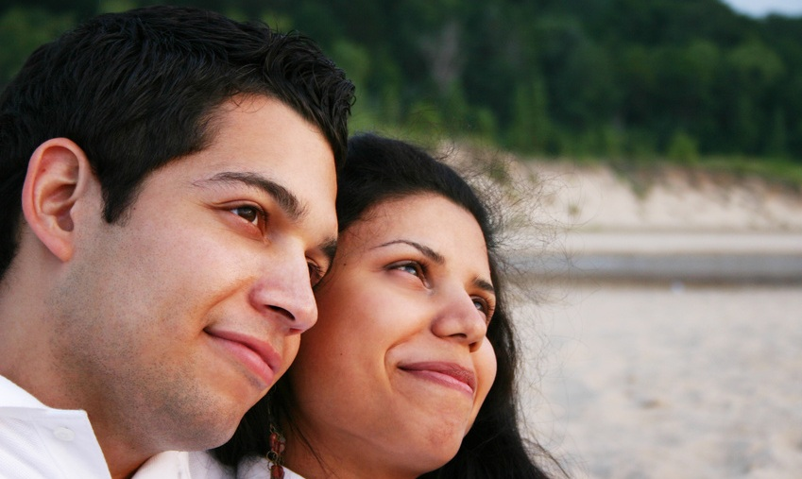
Language Is One Signifier of Culture—the Prevalence of Spanish Means Latino Culture Will Continue to Flourish in the U.S.
66%
Of Hispanics will
speak Spanish at
home in 2020
Source: U.S. Census Bureau “Language Projections: 2010 to 2020” (August 2011)

Slide 11
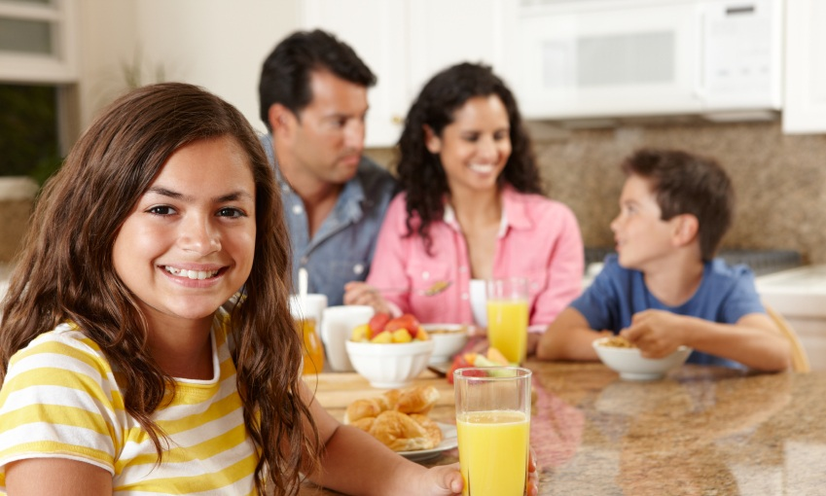
Strong Underlying Trends Will Power Spanish Language Into the Future
Travel
Latino pride
These trends will allow Spanish to flourish and increase the impact it has on the larger U.S.
Mobile revolution
Spanish language media
USH critical mass
Bilingualism seen as an asset

Slide 12
Advertising in Spanish Matters
Nielsen Reports:
Hispanics recall commercials in English as well as non-Hispanics
But the same commercial shown in Spanish bumps up ad recall by as much as +30%
Hispanics like ads 51% more when viewed in Spanish vs. English
Hiring Spanish speaking talent to deliver the script resonates 30% better with Hispanics

Slide 13

Shared Values
Image Source: Denise Carbonell. “black and white trust” https://www.flickr.com/photos/denisecarbonell/

Slide 14

Latin American Cultural Values Underpin a More Collectivist Mindset
Collectivist
Latin American Cultural Values
Family
Respeto
Religion / Spirituality
Simpatía
Optimism
Heritage / Tradition

Slide 15
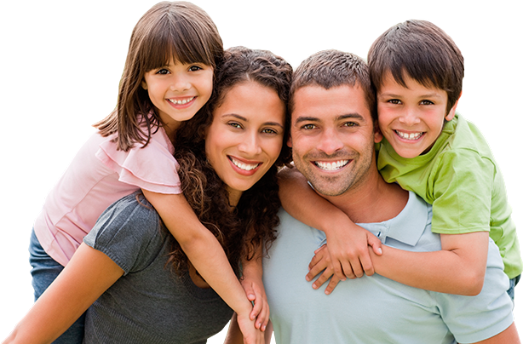
Family
Latin Americans put strong emphasis on not just the immediate family, but the extended / multi-generational family. Individuals are committed and loyal to the family and prioritize the family’s needs over individual needs.
Description
Just 6% of adult Hispanics (18-64) live alone (compared to 11% for non-Hispanics)¹
53% of Hispanics have households w/ children (compared to 30% of non-Hispanics) ¹
Data
“I've only lived in the US for 2 years… My ex boyfriend doesn’t understand how I can be so close to my parents and siblings, or why I miss them so much. I don't think that I can be so unattached with my children when I have them. Like my parents, I would have to have them with me for as long as I can.” (S)
-Female, Bicultural, South American, Foreign Born
Verbatim
Source: American Community Survey (2012), Verbatim from VozLatinum Cultural Influencer Survey (Fall 2013)

Slide 16
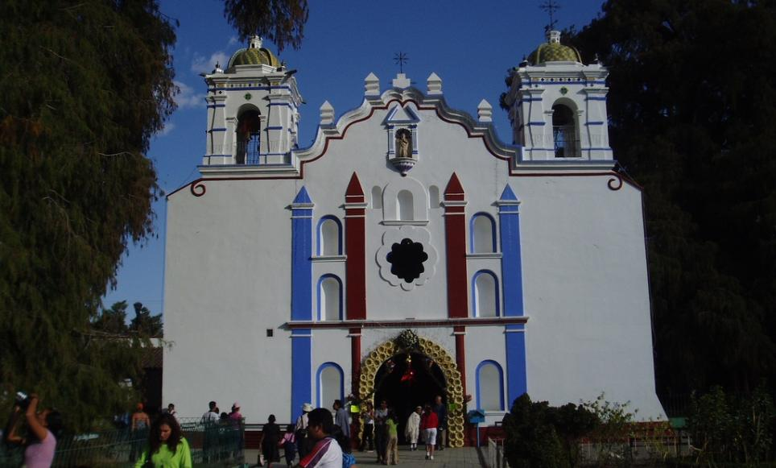
Religion / Spirituality
Latin American religious practice is largely based on the ritualism of the Catholic church mixed with the spiritual characteristics of indigenous cultures. The Catholic church has profoundly impacted many Latin American cultural tenants. The hierarchical structure of society and its undercurrent of machismo are inextricably linked to the orthodoxy of the historically-dominant Catholic church.
Description
Top affiliations: Catholic (55%) and Protestant (22%) ²
From 2010 to 2013 the share of adult Hispanic Catholics decreased from 67% to 55%.²
Data
“The heart of our people is full of joy, music, humor, and mystique, which puts pragmatism and money in a subordinate position.” ¹
-Diego Irarrazavanal: Chilean Holy Cross priest
Verbatim
Source: ¹Irarrazavanal, Diego. “Culture and Religion in Latin America”. ²Pew Research. “The Shifting Religious Identity of Latinos in the United States” (2014).

Slide 17

Optimism
Latinos are generally more optimistic than their non-Hispanic White counterparts. Self-selection accounts for some of this optimism. The hopeful and driven more frequently make the leap-of-faith to immigrate to America.
Description
73% of Hispanics believe that there is a good chance of improving their (and their family’s) standard of living compared to 46% of White individuals¹
Data
“It’s like he (undocumented dad) got all this, this is a lot …but he worked for it. So I think that if I work for it too that I may get something of what he got…Even more…’cause I was born here. It’s more of an advantage. You isn’t got to worry about getting stuck there, like there’s no more jobs for you ‘cause you weren’t born here … it’s just up to me to do what I got to do.”
-Male²
Verbatim
Source: AP & NORC “The Public Mood: White Malaise But Optimism Among Blacks, Hispanics” (2013). Rendón , Maria. “Optimism & Belief In The American Opportunity Structure: The Case Of Urban Second Generation Latino Young Men” (March 2014)

Slide 18
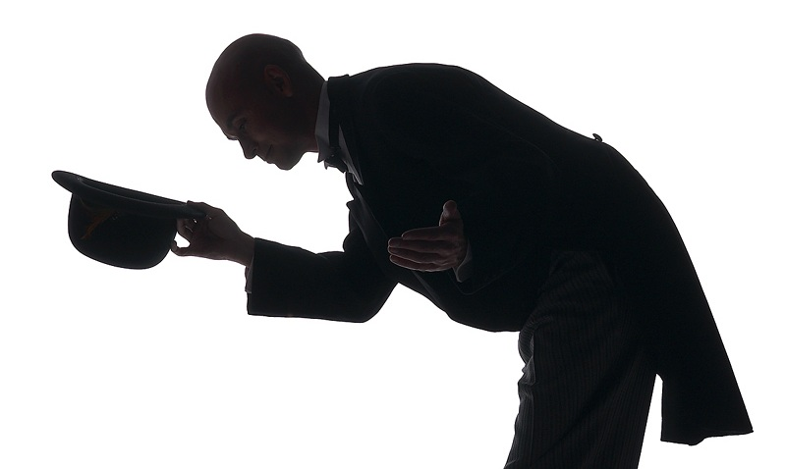
Respeto
Many Hispanic interpersonal relationships are governed by “respeto”: the suitable, deferential behavior to others based on age, sex, social position, title, economic status, etc.
Description
Latin American cultures score higher on power distance measures (the extent to which the less powerful members of institutions and organizations within a country expect and accept that power is distributed unequally): 80 weighted average compared to 40 for the U.S.¹
Data
“Parents need to know that they are the authority, they have to set limits (even if [teenagers] get angry and try to rebel), the love, discipline, two-way communication, and respect, are the elements that are important when raising and helping teenagers to become healthy adults, mature, and capable of being able to live in the future.” (S)
-Female, Bicultural, South American, Foreign Born
Verbatim
Source: ¹The Hofstede Centre. Weighted to U.S. distribution of Latin American origin, to better represent U,S. Latino population. Verbatim from VozLatinum Cultural Influence Survey (Fall 2013)

Slide 19
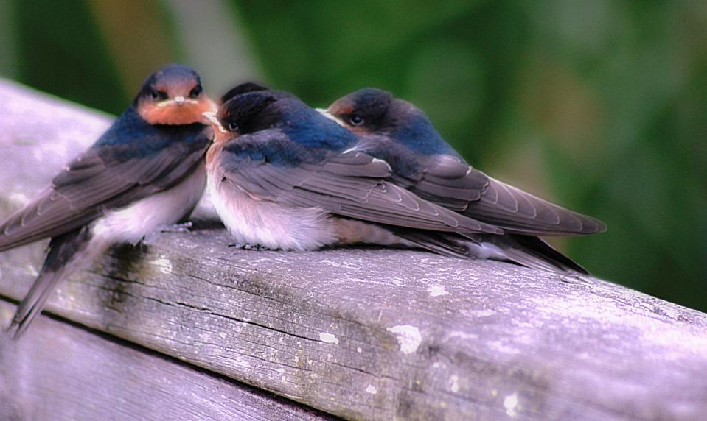
Simpatía
“Hispanics behave in order to avoid conflict and foster positive, harmonious interpersonal relationships.”¹
Image Source: PsJeremy. “4 Juvenile swallows huddled together” https://www.flickr.com/photos/psjeremy/
Description
Hispanics are more likely to exhibit acquiescence bias when taking surveys (propensity to agree with statements regardless of context), resulting in an increased likelihood of over-agreement.²
Data
Concerning Culturally Sensitive Medical Care
“They may even be reluctant to ask questions or admit they are confused about their medical instructions or treatment. Associated with this is a cultural taboo against expressing negative feelings directly. This taboo may manifest itself in a patient’s withholding information, not following treatment orders, or terminating medical care”³
Verbatim
Source: ¹Shwartz, Audrey. “Latinos’ Collectivism and Self Disclosure in Intercultural and Intracultural Friendships and Acquaintanceships” (2009). ²Van Varenbergh and Thomas. “Response Styles in Survey Research: A Literature Review of Antecedents, Consequences, and Remedies” (2012) ³DHHS “Quality Health Services for Hispanics: The Cultural Competency Component” (2001)

Slide 20
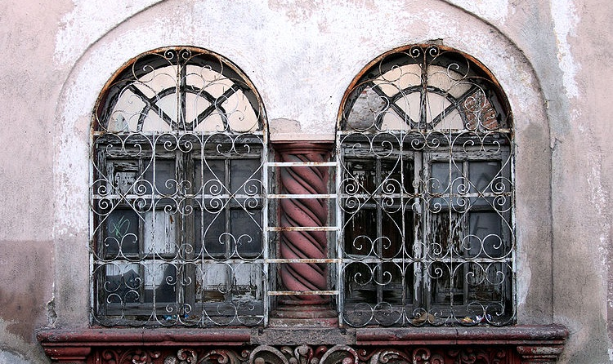
Heritage/Tradition
U.S. Latinos across all acculturation levels believe in the importance of keeping both their cultural heritage and their language. This manifests itself in the passion points that define and aggregate to culture: celebration of every holiday, music, dance, food, language, soccer, and a distinct humor.
Image Source: Tomas Castelazo. “Old window mexico” http://commons.wikimedia.org/wiki/Commons:Picture_of_the_Year/2010/Galleries/Interiors/Large#mediaviewer/File:Old_window_mexico.jpg
Description
I Enjoy Eating Traditional Hispanic/ Spanish Food:¹
Total Hisp.
Acculturated
Bicultural
Unacculturated
% agree
83%
84%
84%
81%
Data
I Often Celebrate Holidays From Hispanic Countries:¹
% agree
Total Hisp.
Acculturated
Bicultural
Unacculturated
83%
84%
84%
81%
“I am nostalgic and proud, and I think of a rich native history. I think of artwork in jade, I think of Diego Rivera, I think of colonial Spanish style. I think of open-air patios and extended families getting together for meals and parties. I think of ancient Mexico, the Olmeca and Azteca and Maya, and how they are still celebrated and admired, how their unique artifacts live on. I think of my passionate response to my own life, and how I feel ties to my culture, past and present, in that passion.”
-Female, Mexican, Bicultural, U.S. Born
Verbatim
Source: ¹Simmons NHCS (Winter 2014), Verbatim from VozLatinum Cultural Influencer Survey (Fall 2013)

Slide 21
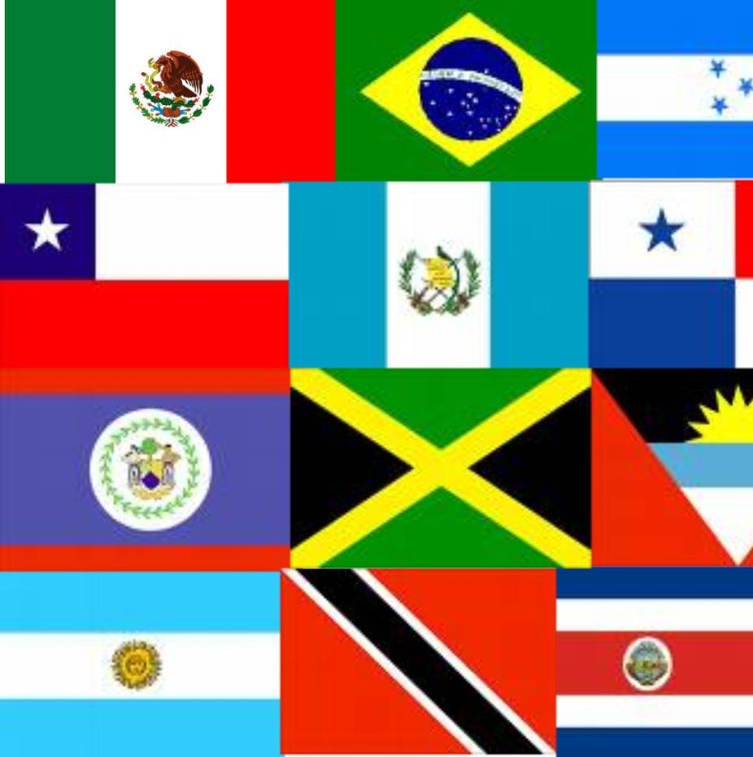

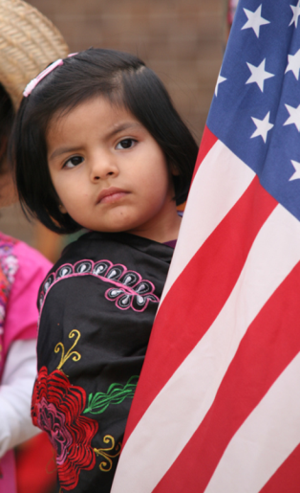
Latin American and American Cultural Values Intersect within Bicultural U.S. Hispanics
American
Latin American
Bicultural U.S. Hispanic Americans
Image Source: Cliff. “Proclamation Ceremony” https://www.flickr.com/photos/nostri-imago/

Slide 22
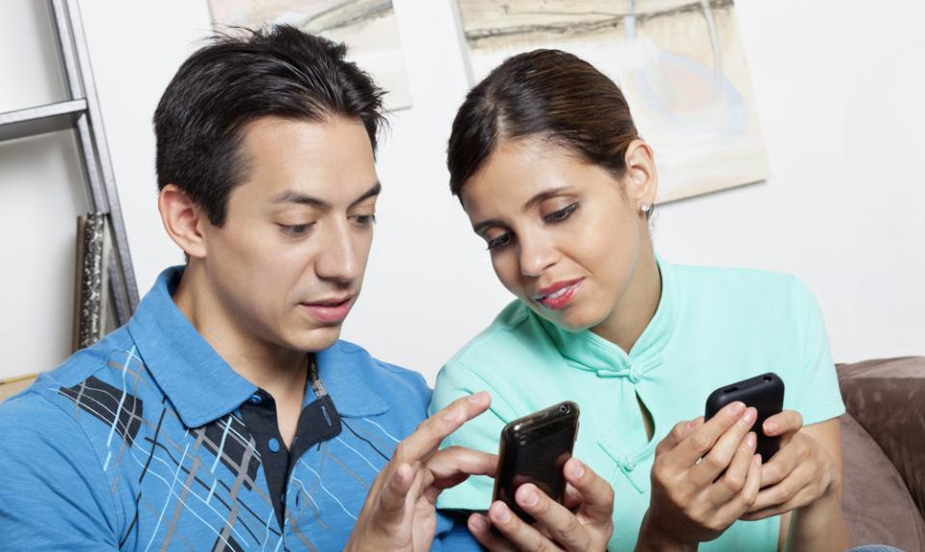
The U.S. Hispanic Bicultural Identity
Bicultural Identity
“I have to find a happy medium and try to take the best from both cultures. I love my Latin culture, but I also like certain parts of American culture, such as work ethnic”
-Female, Mexican, Bicultural, Foreign Born
“I have no problem balancing my Hispanic and American culture. I am proud to be both American and Latino. I find it’s others who have a problem with my dual culture, and, as far as I’m concerned, that’s their problem not mine”
-Male, Puerto Rican, Acculturated, U.S. Born
Source: VozLatinum Cultural Tensions Forum (Feb. 2012)

Slide 23
Latin Americans Tend to Value Interdependence
Latin Interdependence
American Independence
Family #1
Self-sufficiency
Family helps family
Successful self → helps family
High contact
Low contact
Respect authority
Challenge authority
Acceptance of how things are
Opportunity for all
Stability
Drive to the future
Notes:
Animate horizontally

Slide 24
New U.S. Bicultural Values
Latin
Interdependence
American
Bicultural
American
Independence
Family #1
Personal success motivated by benefit to family
Self-sufficiency
Family helps family
Succeeds to help family
Succeeds, then helps family
High contact
Different types of relationships with different people
Low contact
Respect authority
Questioning authority not viewed as disrespectful
Challenge authority
Acceptance of how things are
Optimism about economic advancement
Opportunity for all
Status quo
Growing awareness of individual and collective power
Drive to the future

Slide 25

Cultural Influence and Crossover
Image Source: Audrey. “Drop Experiments" https://www.flickr.com/photos/audreyjm529/

Slide 26
Latinum Cultural Influence Model
Isolation
Cultural Openness
Cultural Engagement
Influence

Slide 27
We Identified the Four Factors that Underlie Cultural Influence
From Latinum’s Fall 2013 Cultural Influence work:
Cultural Engagement
An individual’s connection to the his/her own cultural heritage
Cultural Openness
The degree to which an individual appreciates, receives, and internalizes a novel culture
Influence
An individual’s capacity to sway another’s attitudes and behaviors because of his or her perceived credibility and social capital
Isolation
An individual's distrust or avoidance of other cultures

Slide 28
Hispanics Are Prime Cultural Influencers
Cultural Engagement
Hispanic
180
NH: Af-Am
168
NH: Asian
111
NH: White
66
Cultural Openness
Hispanic
110
NH: Af-Am
154
NH: Asian
93
NH: White
68
Influence
Hispanic
112
NH: Af-Am
111
NH: Asian
72
NH: White
87
*Indexed to total market (100)
Source: Latinum Cultural Influence (Fall 2013)

Slide 29
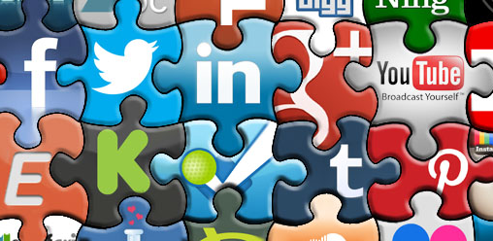
In the Social Media Realm
Image Source: greyweed “SMM-Jigsaw-Banner” https://www.flickr.com/photos/21986855@N07/
Hispanics share twice as often as non-Hispanics, and those who do share share 5x more…
…and the topic they are most likely to share about (relative to non-Hispanics): Culture and Religion
Source: ShareThis: Online Sharing Behaviors of Hispanic Consumers 2014

Slide 30
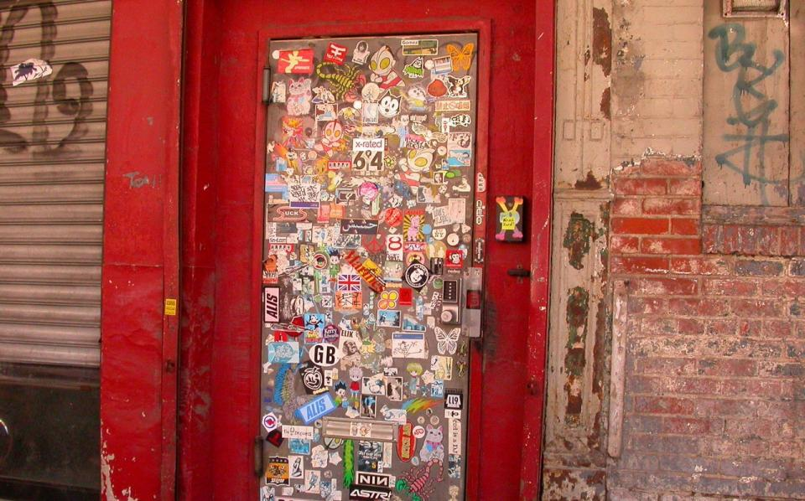
Young, Urban, Hispanic Millennials are Helping to Remake America
Young, Urban, Hispanic Millennials are at the center of cultural influence
Cultural Influence
Younger Population
Urban millennials are more likely to be influential, engaged, and open relative to total population AND non-urban millennials
% of total pop.
Hispanics:
-Under 35 62%
-18 to 34 28%
Non-Hispanics:
-Under 35 44%
-18 to 34 22%
Image Source: Ioan Sameli. “Cool Door” https://www.flickr.com/photos/biwook/

Slide 31
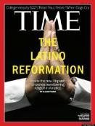
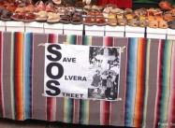
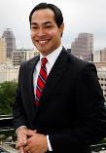
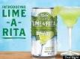
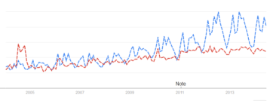
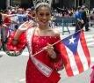
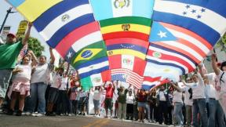

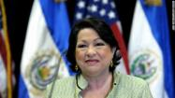

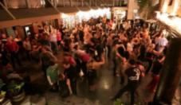
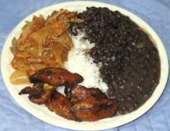
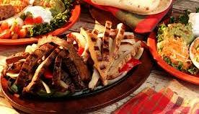
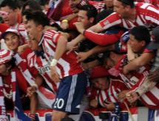

Latino Cultural Influence at Play in the U.S.
U.S. Hispanics are at the nexus of many larger socio-cultural trends
Google Trends: Guacamole (blue) vs. Ketchup (red) Searches in the U.S.

Slide 32
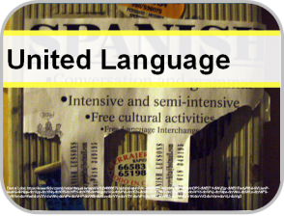
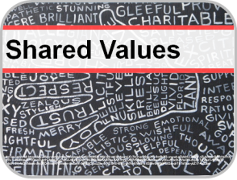
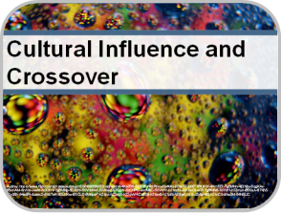
In Conclusion
U.S. Hispanics are:
United by language
+
Across shared values
Driving cultural change

